Slide 1
Label 1
Collect data
Label 2
Label 3
Label 4
Data
Label 5
Label 1
Label 1
Label 2
Label 2
Label 3
Features
Label 3
Label 4
Preprocessing
Feature extraction
Features
Data
Label 5
Features
Label 4
Features
Label 5
Features
“Hyperparameters”
Label 1
Training
Features
Label 2
Features
Label 3
Features
Label 4
Features
Label 5
Model
Features
“Parameters”

Slide 2
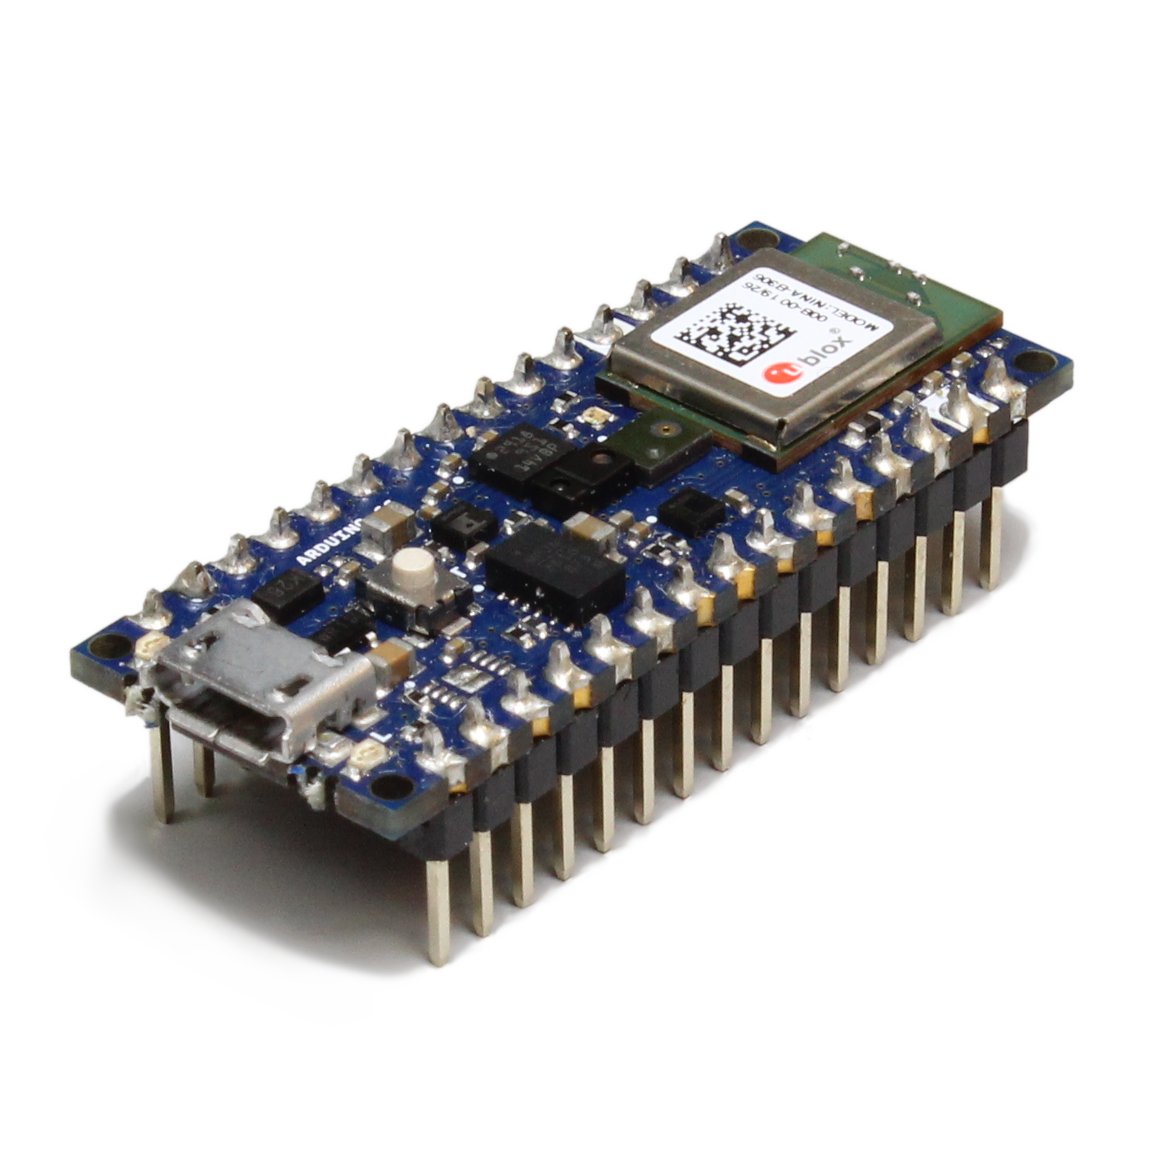
Class 1
Collect data
Preprocessing
Feature extraction
Model
Class 2
Class 3
Class 4
Inference: using the machine learning model to make predictions on unseen data in the wild

Slide 3
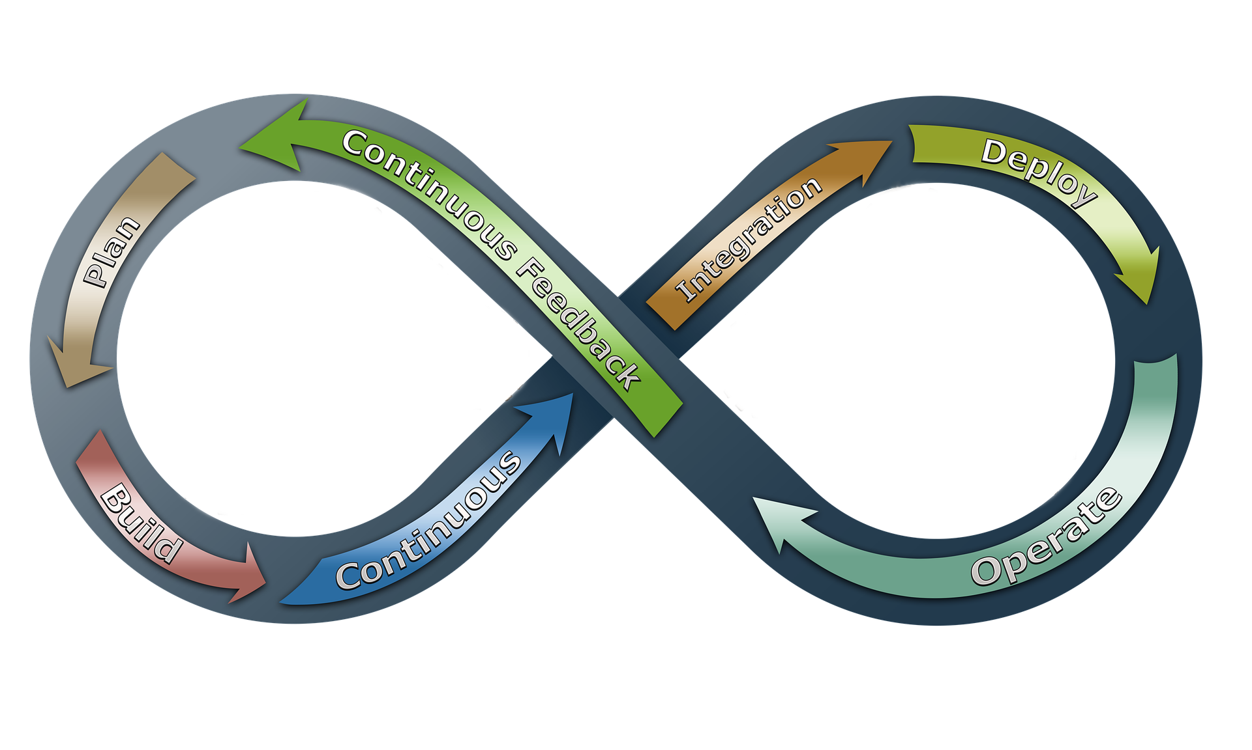
Dev
Ops

Slide 4


